Slide 1
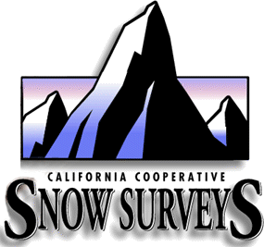


Water Supply Forecasting Basics

Slide 2
California Cooperative Snow Surveys Program
  79 year old program established in 1929
  Using snow sampling methods first developed by Dr. James Church (Univ. of Nevada – Reno) at the Mt. Rose (Nevada) Snow Course
  Over 240 courses
  Over 50 agencies help collect Snow Data
  Dozens more agencies contribute other data (precipitation or runoff data)
  Most of these agencies contribute financial support to the program
  Calif. Coop. Snow Surveys program has operating budget in excess of $1.5 million annually (primary expense is data collection and data network maintenance)

Slide 3
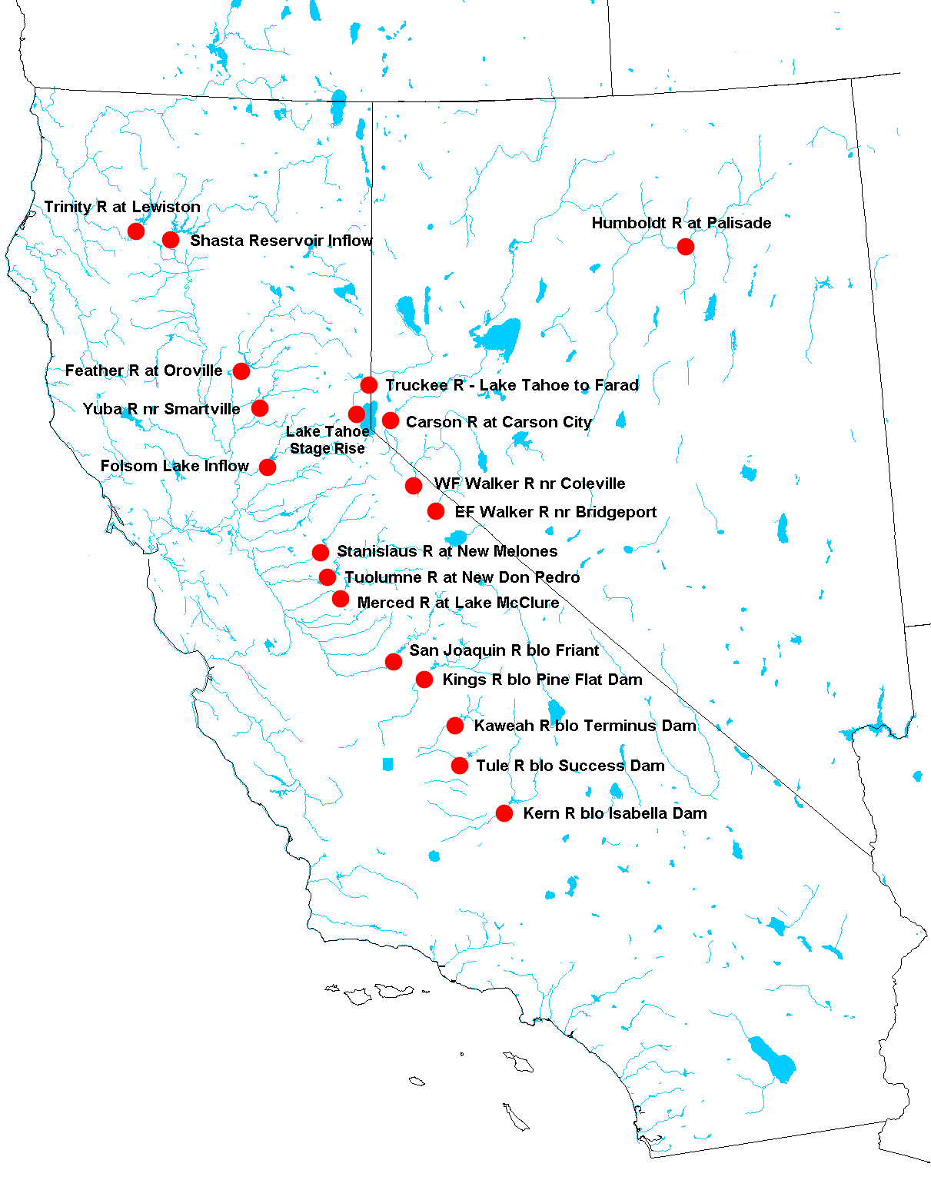
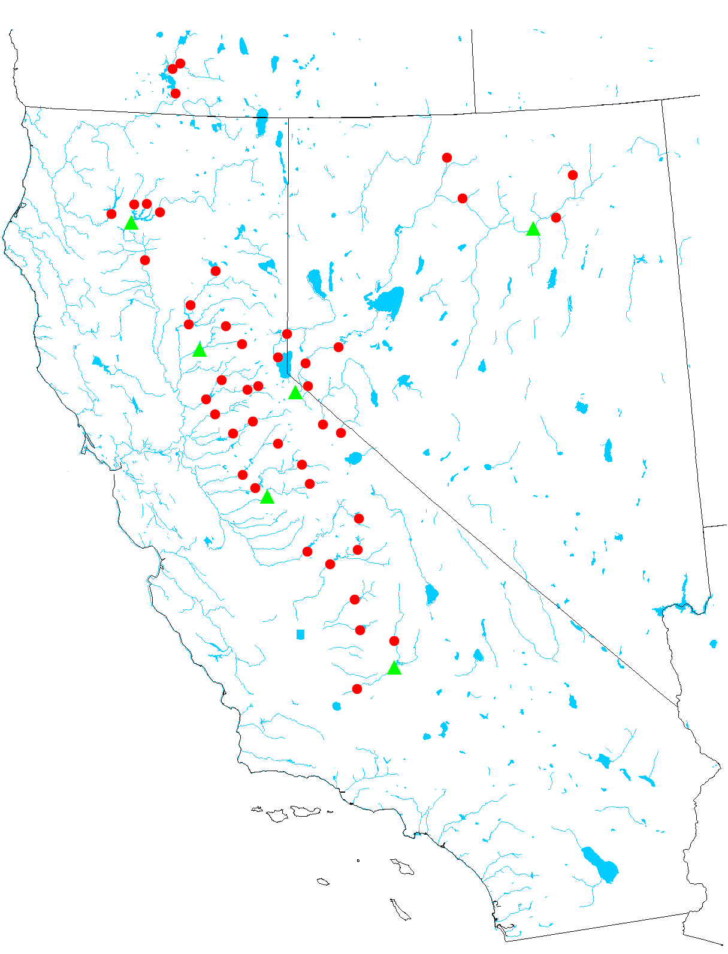
Water Supply Forecast Locations
Snowmelt Runoff Points
Water Supply Forecast Points

Slide 4
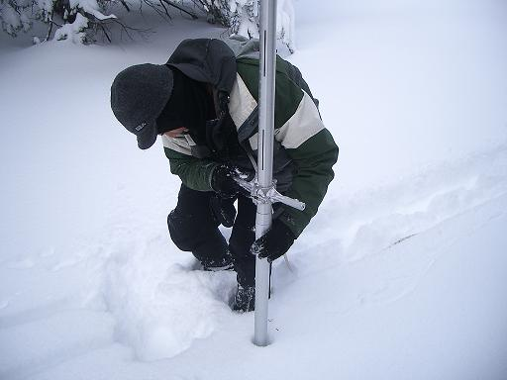
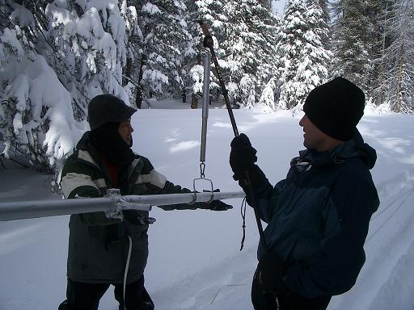
How is data collected?
Manual Snow Surveys
  Conducted within 10 day window surrounding the first of month
  Conducted January thru May – varies per snow course
  Inclement weather Can Effect the collection
  DWR Staff: Frank Gehrke, John King, Rick Louie & Kenny Karcher
  Many others from many other agencies statewide

Slide 5
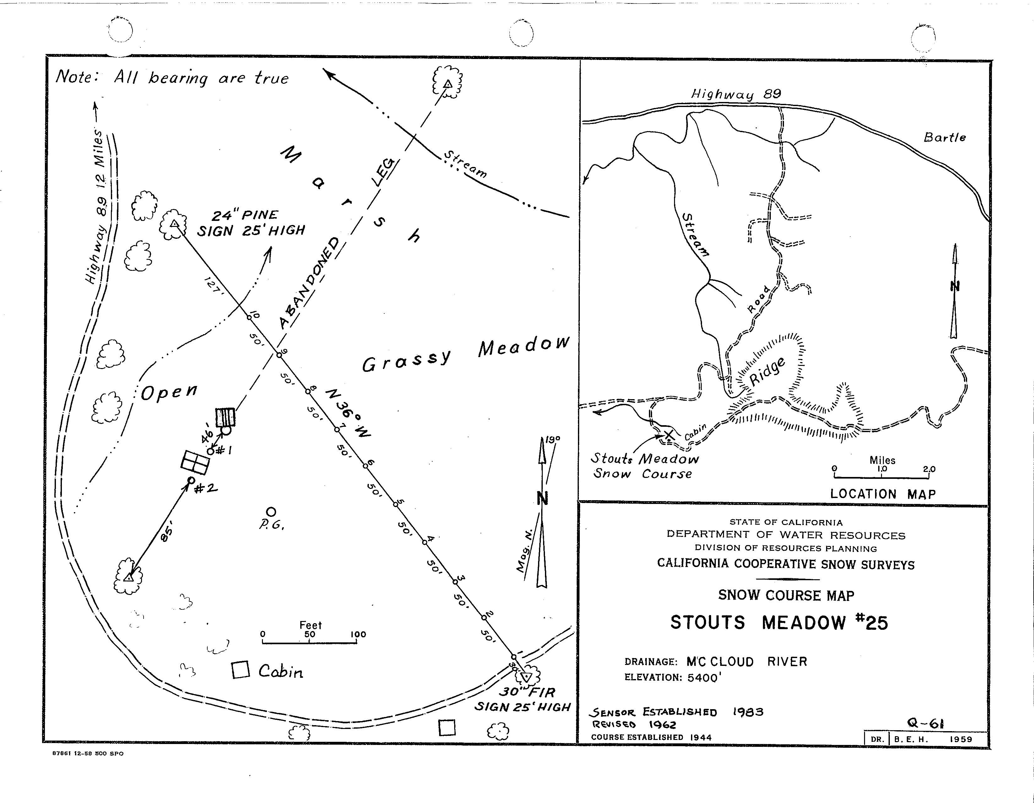
Manual Snow Survey
Example Snow Course
Stouts Meadow
McCloud River Basin
Measured across a transect
Precise measuring points on transect
Same points measured each month
Allows for comparisons from month to month
Long Term Averages

Slide 6
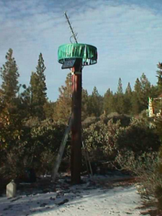
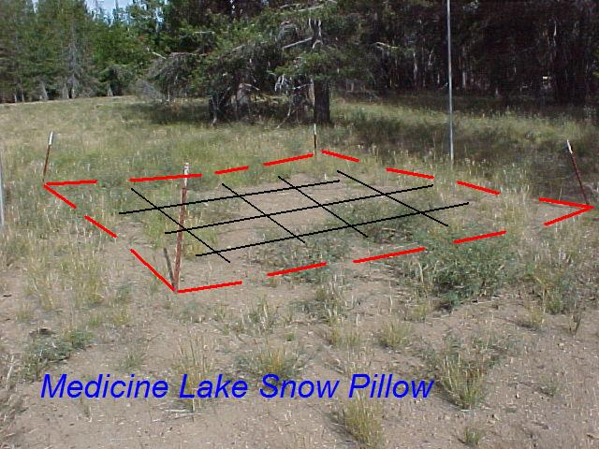
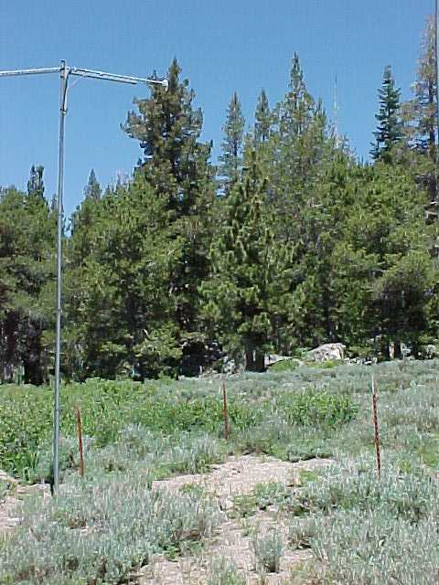
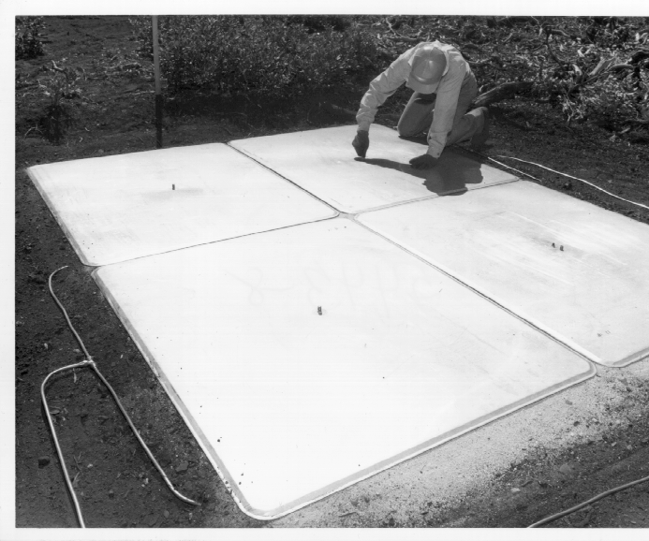
How is data collected?
Other Methods
Rain Gage
SNOW PILLOWS
Snow Depth Gage

Slide 7
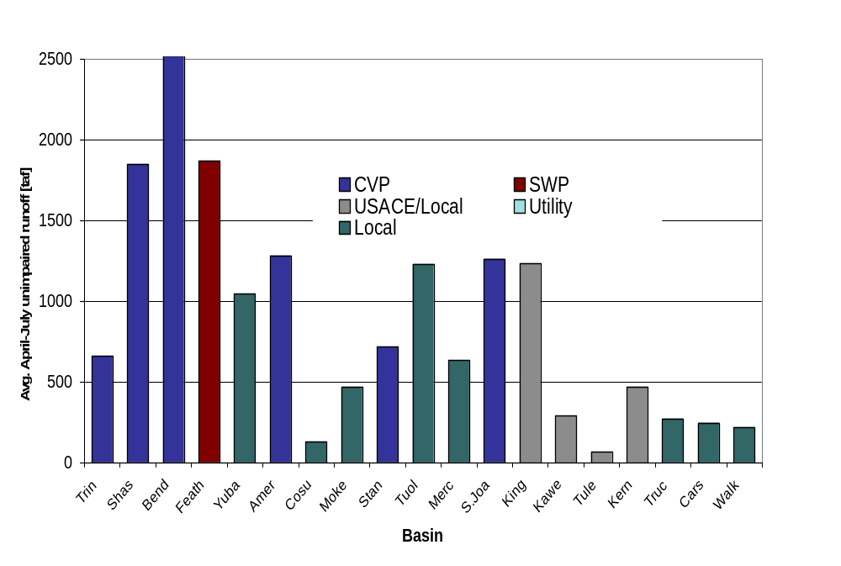
Water Supply Forecast Basins
Primary Interest

Slide 8
Where Does the Data Come From?
National Weather Service Offices
US Bureau of Reclamation
US Army Corps of Engineers
California State Water Project
US Geological Survey
National Park Service
US Forest Service
Natural Resources Conservation Service
City and County Water/Flood Control Departments and Districts
General Public – NWS weather observers
Public/Private Utilities
Irrigation Districts

Slide 9
Water Supply Forecasting Products

Slide 10
Two Basic Water Supply Products
Bulletin 120 – Seasonal runoff forecast which highlights the April – July runoff.
Water Supply Index – Water Year Classification product used to determine the Water Year Type.

Slide 11
Snow Surveys Water Supply Forecast Products
Seasonal … … …
Monthly Bulletin 120 A-J Runoff Forecasts (Feb – May)
Weekly Bulletin 120 Updates (Feb – June)
Spring Snow Melt Forecasts (April – June)
Sacramento River Accretions (Oct – May)
… … … … Water Year
Sacramento River Water Supply Index
(SRR and SVI) (Oct-May)
San Joaquin River Water Supply Index
(SJI) (Oct-May)

Slide 12
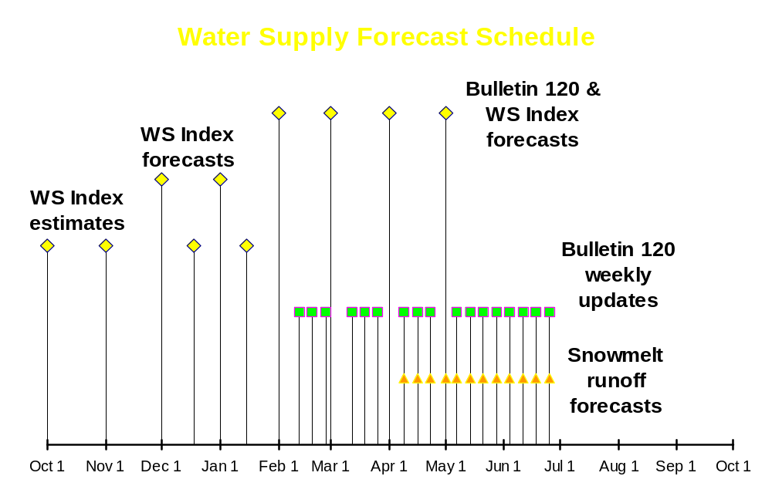

Slide 13
Water Supply Index (WSI)

Slide 14
Water Supply Index (WSI)
Monthly Updates published October thru May
WSI procedures are not currently set up for mid-month updates
Regional forecasts are made for:
  Sacramento River Basin Runoff (SRR): Sum of unimpaired flows for Sacramento River at Bend Bridge, Feather, Yuba, and American Rivers
  Sacramento Valley Index (SVI): Water year type index determined with 40% current A-J runoff, 30% Oct-Mar runoff, 30% previous year’s index (where runoff is SRR sum as above)
  San Joaquin Valley Index (SJI): Water Year type index for Stanislaus, Tuolumne, Merced, and San Joaquin Rivers but with 60-20-20 breakdown

Slide 15
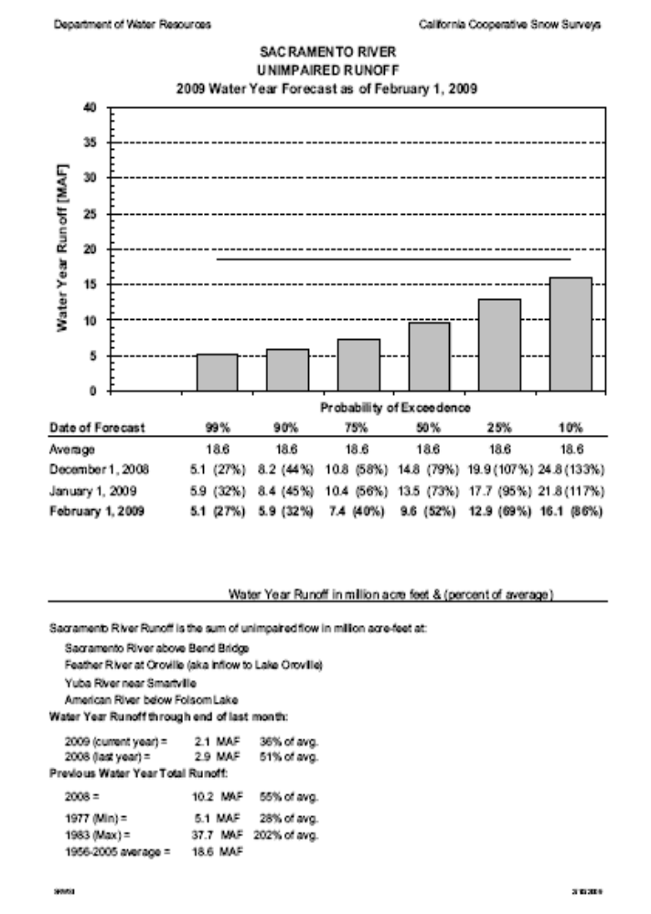
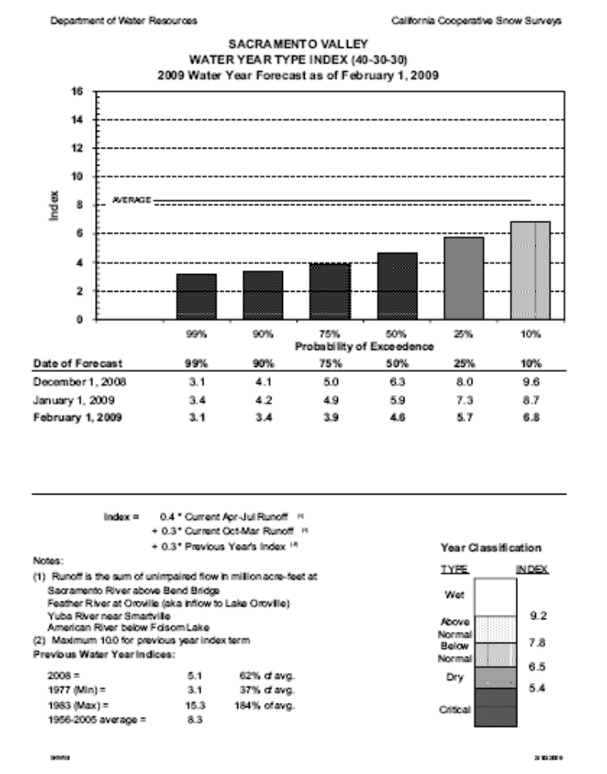
Water Supply Index (WSI)

Slide 16
Bulletin 120

Slide 17
BULLETIN 120 – Water Conditions in California
Monthly Bulletins published February thru May
Weekly Updates published February thru June
B120 uses regression equations to determine April thru July runoff forecasts for statewide river basins
Regression Formula variables include:
  October – March Precipitation Index
  April – July Precipitation Index
  High and Low Snow Indicies
  Previous fall and spring runoff
  50 year historic database (1956-2005)

Slide 18
BULLETIN 120 – Continued
Statewide forecasts are made for:
  North Coast Region: Trinity, Scott, and Klamath Rivers
  Sacramento River Basin: Lake Shasta Tributaries, Sacramento River at Bend Bridge, Feather, Yuba, and American Rivers
  San Joaquin River Basin: Cosumnes, Mokelumne, Stanislaus, Tuolumne, Merced, and San Joaquin Rivers
  Tulare Lake Region: Kings, Kaweah, Tule, and Kern Rivers
  East Sierra Drainage: Truckee, Carson, Walker, and Owens Rivers
Monthly forecasts are compared with NWS-CNRFC forecasts for both confidence and agreement
B120 Procedures are considered our best procedures

Slide 19
BULLETIN 120 – Continued
Other information published in Bulletin 120
  Historical max., min., and averages for each forecast point
  80% probability spread
  Water year unimpaired runoff forecasts for main valley streams
  Regional hydrologic summaries
  Statewide precipitation and snowpack conditions
  Major water project reservoir storage conditions
  Contact information for Snow Surveys staff

Slide 20
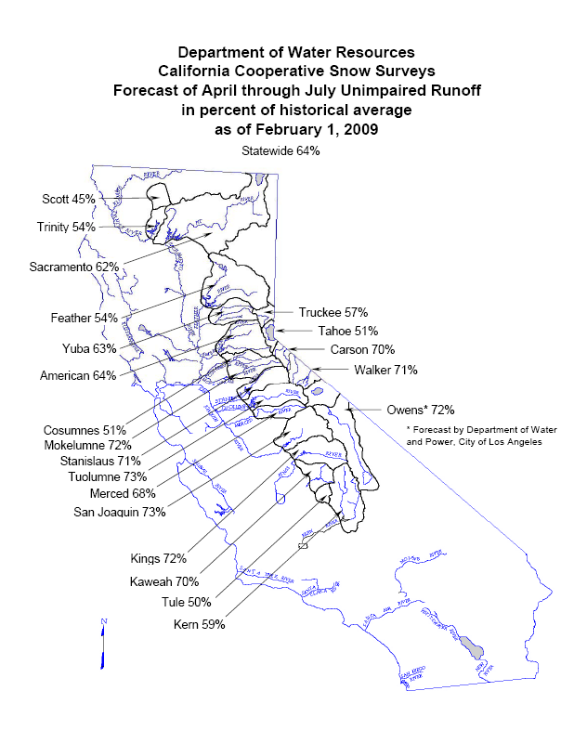

Slide 21
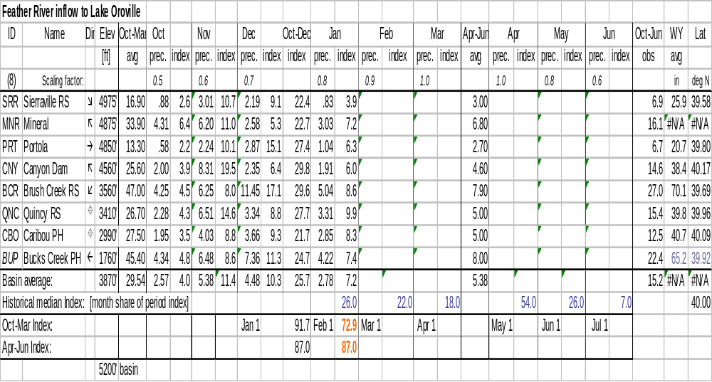
Precipitation Index Calculations
The precipitation variables of the regression equation are determined by calculating a precipitation index based on yearly and monthly averages over a mix of stations representing the basin.

Slide 22

Precipitation Index Issues
Issues:
  Precipitation station mix may be limited
    May have elevation or east-west bias
    May have out of basin station bias
  Data Collection may not be thorough
    Missing stations cause unintentional biases
Resolution:
  Use computation techniques to estimate precipitation at unaccounted for elevations or latitudes
  Use alternate stations to help estimate missing data

Slide 23
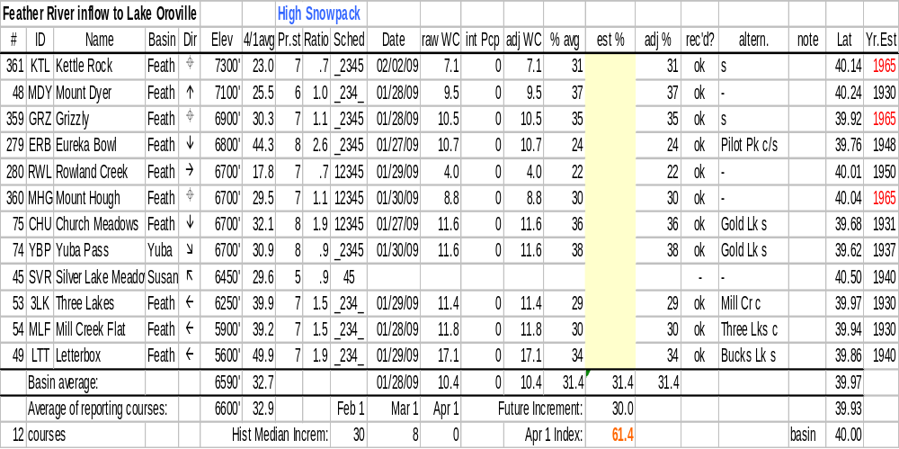
Snow Index Calculations
Similarly, the snow pack variables of the regression equation are determined by calculating a snow index based on yearly and monthly averages over a mix of stations representing the basin. In some cases, the basin is split into a high elevation and low elevation snow pack index to give ultimate consideration of basin snow.

Slide 24
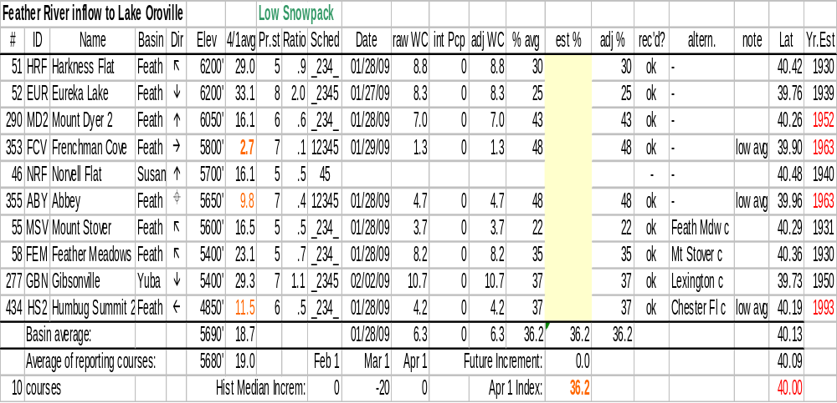
Snow Index Calculations
Similarly, the snow pack variables of the regression equation are determined by calculating a snow index based on yearly and monthly averages over a mix of stations representing the basin. In some cases, the basin is split into a high elevation and low elevation snow pack index to give ultimate consideration of basin snow.

Slide 25
Snow Index Issues
Issues:
  Snow course mix may be limited
    May have elevation or east-west bias
    May have out of basin station bias
    Budget cuts have worsened these concerns
  Data Collection may not be thorough or have quality assurance
    Missing stations cause unintentional biases
    Lack of quality snow course measurements requires alternate source data or re-measurement
    IRONICALLY, harsh weather will often delay or prohibit data collection
    Relying on snow pillows is not as good as manual snow course measurements

Slide 26
Runoff Data Issues
Full Natural Flow (FNF)
  146 terms needed to complete FNF calculations
  25 sources of FNF data
  Some flow values are estimated based on historical records
  FNF calculations need to be done by third business day in order to have Water Supply Forecast products available as promised.
  Timeliness of data is crucial

Slide 27
Regression Equations:
  Developed 1989 – Updated in 2006
  Multiple Equations per basin available for comparison (includes dry and wet year equations)
  Additional May 1 equation compiled for use if necessary (for extreme cases)
  Variables Used:
    R = Oct-Mar runoff
    S_{h} = High Snow Pack
    S_{L} = Low Snow Pack
    P_{o} = Oct – March Precipitation
    P_{s} = April – July Precipitation
    Constant

Slide 28
April-July Forecasts
“Like Solving a ‘Multi-Dimensional Puzzle’ Each Week”
  Regression Equations
    Based on water years 1956-2005
  “Year-Type” Equations
    Interactive tool creates regression equations based upon years that fall under desired specifications
    Based on water years 1931-2007
  Cross-Basin Equations
    Uses historical relationships to forecast April-July runoff for a given basin as a function of forecasted runoff at surrounding basins
  Exceedence Tables
  “Physical” Models
    Feather River PRMS, for example

Slide 29
Forecasting: Science versus Feel
  Regression Equations Generally Work well…
    But…
    We rely also on feel because …
    Data is not always perfect
    Members of Calif. Cooperative Snow Surveys have many years of experience
    Average Snow pack ≠ Average Runoff
    Average Precipitation ≠ Average Runoff
    ??? = Average Runoff
    Average Runoff ≠ Full Reservoirs

